Slide 1
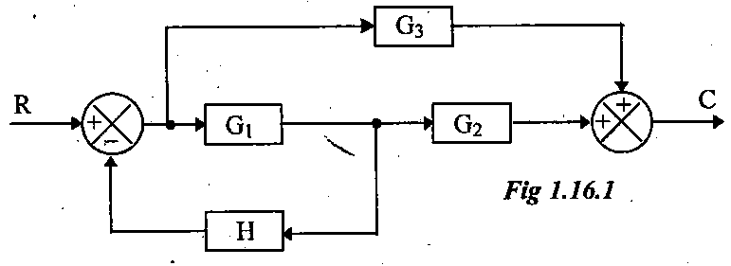
1).Reduce the block diagram shown in fig and find C/R?

Slide 2
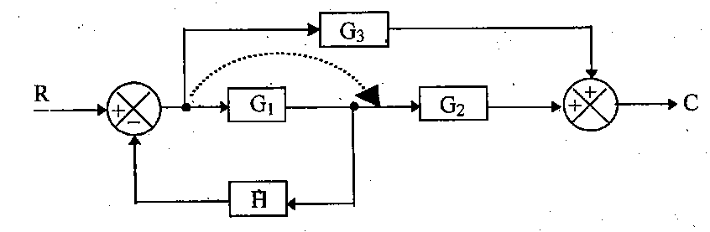
Step 1: Move the branch point after the block

Slide 3
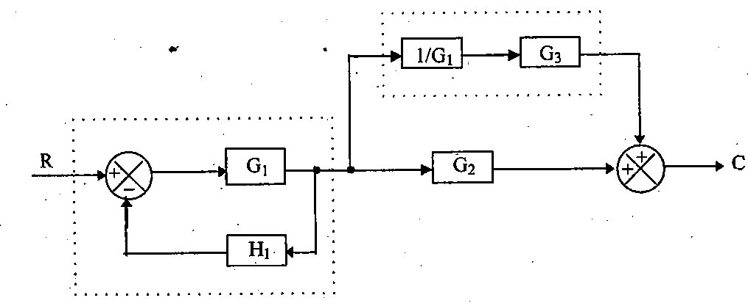
Step 2: Eliminate the feedback path and combining blocks in cascade

Slide 4
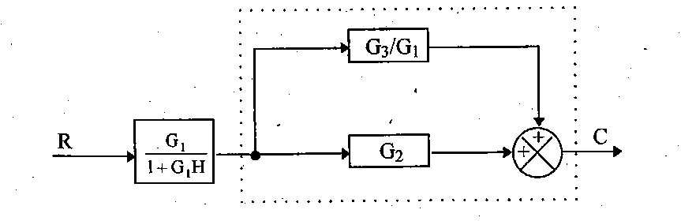
Step 3: Combining parallel blocks

Slide 5
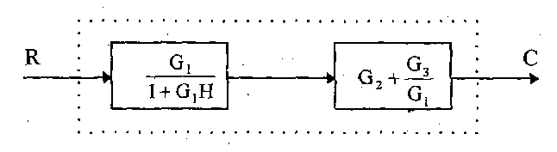

Step 4: Combining blocks in cascade
The overall transfer function of the system is

Slide 6
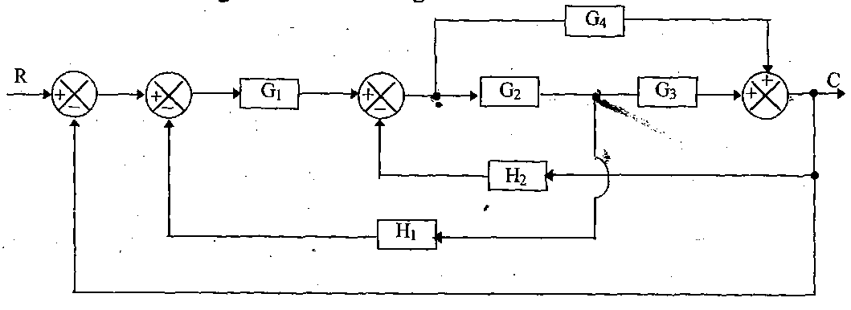
2).Using block diagram reduction technique find closed loop transfer function of the system whose block diagram is shown in fig?

Slide 7
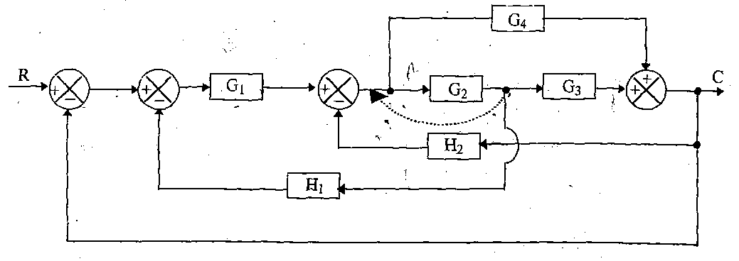
Step 1: Moving the branch point before the block

Slide 8
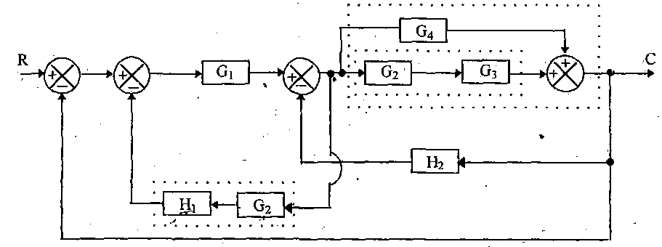
Step 2:combining the blocks in cascade and eliminating parallel blocks

Slide 9
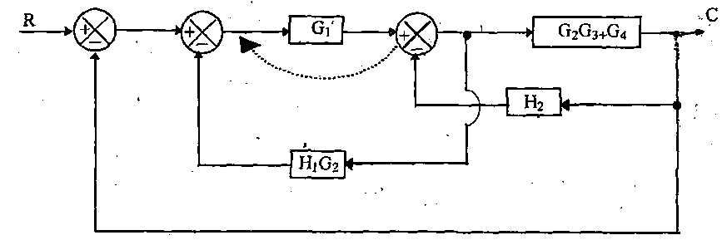
Step 3:movining summing point before the block

Slide 10
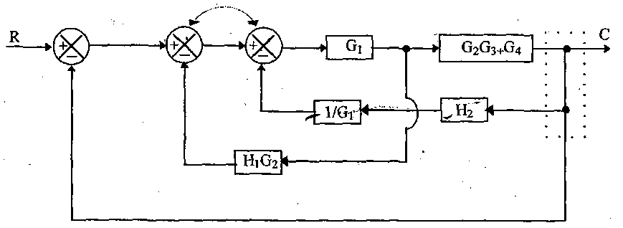
Step 4:interchanging summing points and modifying branch points.

Slide 11
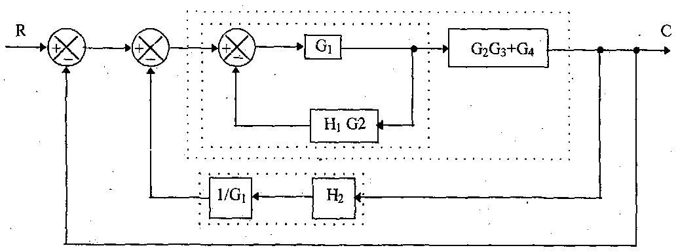
Step 5:Eliminating the feed back path and combining blocks in cascade.

Slide 12
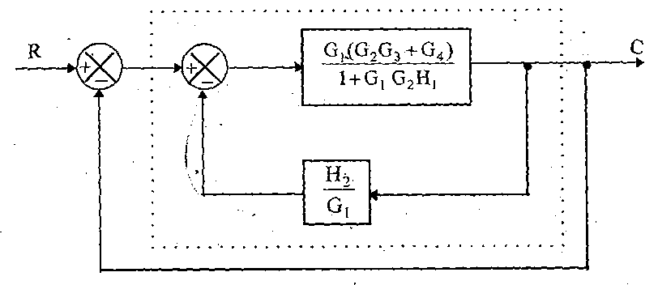
Step 6: Eliminating the feedback path

Slide 13
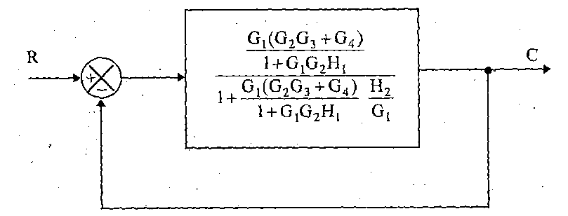

Slide 14
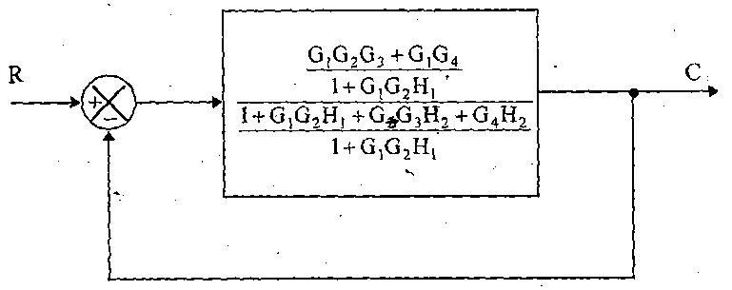

Slide 15
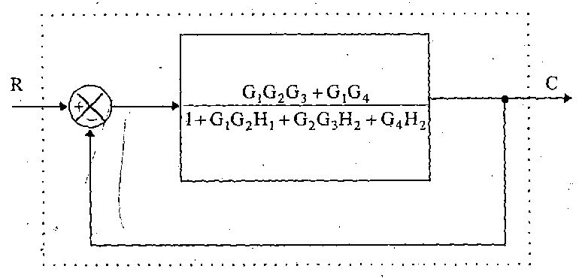
Step 7: Eliminating the feedback path

Slide 16
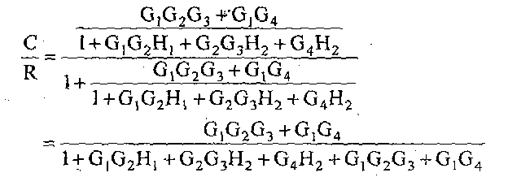

Slide 17

The overall transfer function is given by

Slide 18
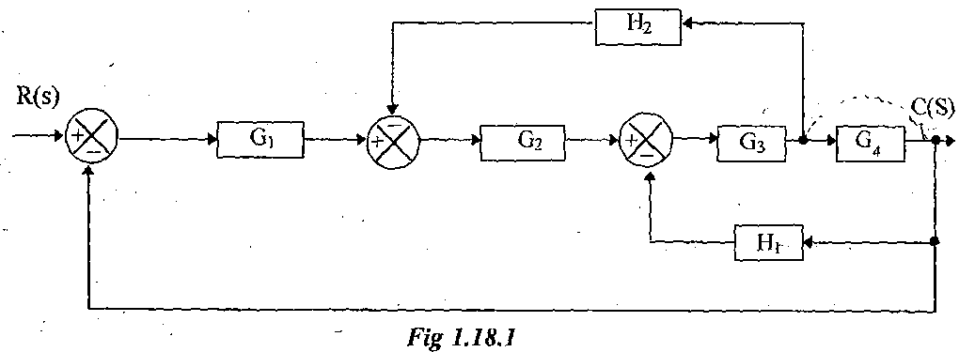
3).Determine the overall transfer function for the system shown in fig?

Slide 19
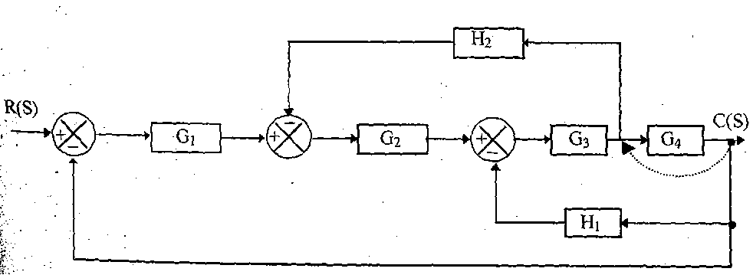
Step 1: Moving the branch point before the block

Slide 20
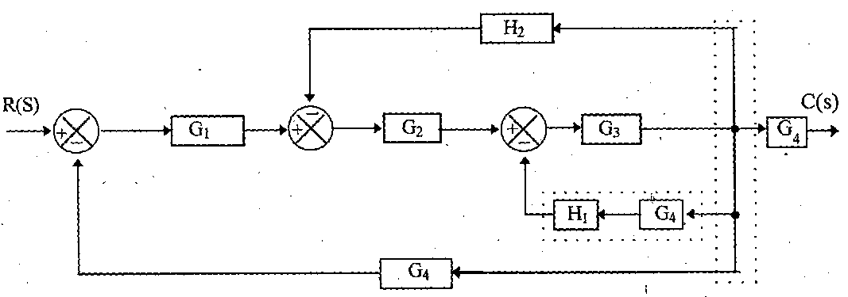
Step 2: Combining the blocks in cascade and rearranging the branch points

Slide 21
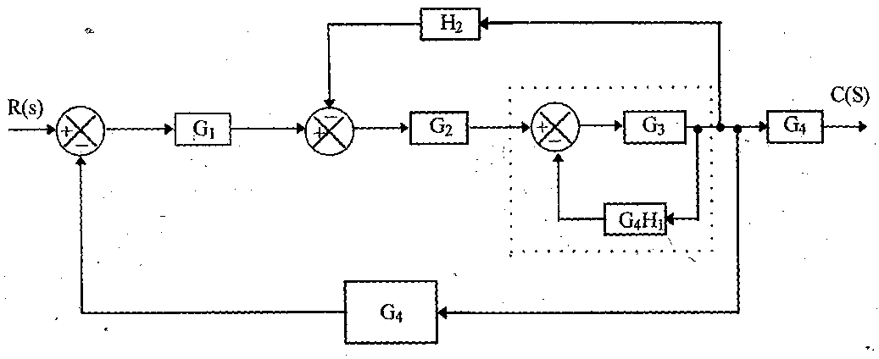
Step 3: Eliminating the feedback path

Slide 22
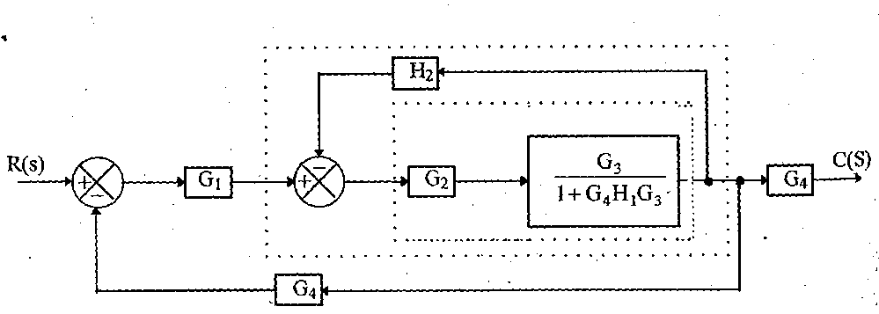
Step 4: Combining the blocks in cascade and eliminating feedback path

Slide 23
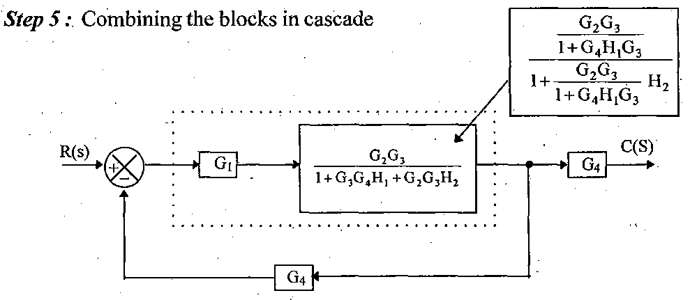

Slide 24
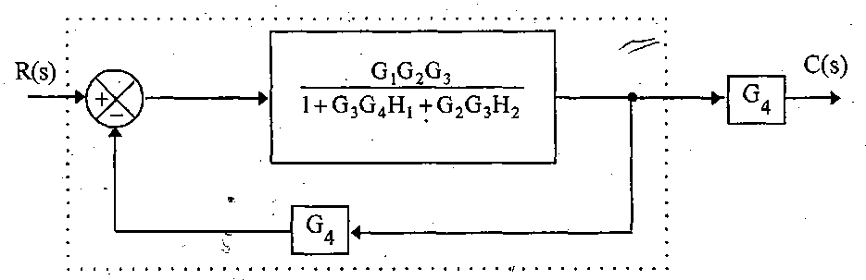
Step 6: Eliminating the feedback path

Slide 25
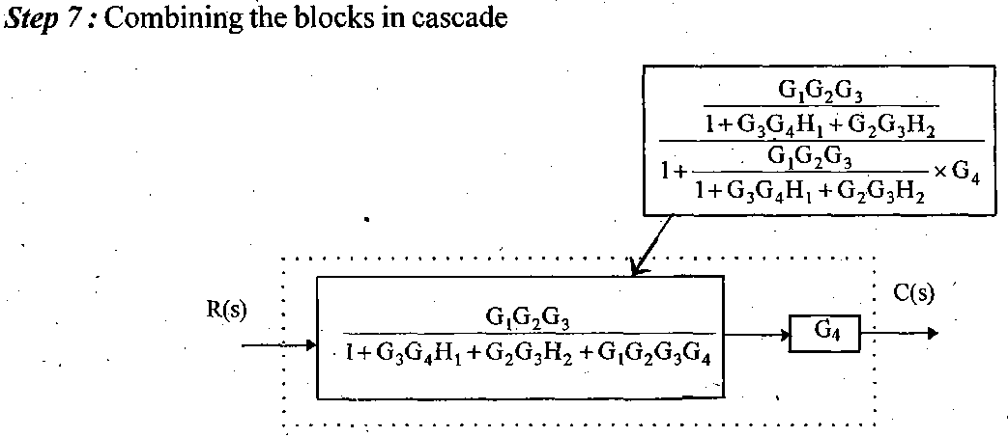

Slide 26

The overall transfer function of the system is given by

